Slide 1

AI training group
Weekly Report
Nguyen khai phu – JUL 21 2023

Slide 2
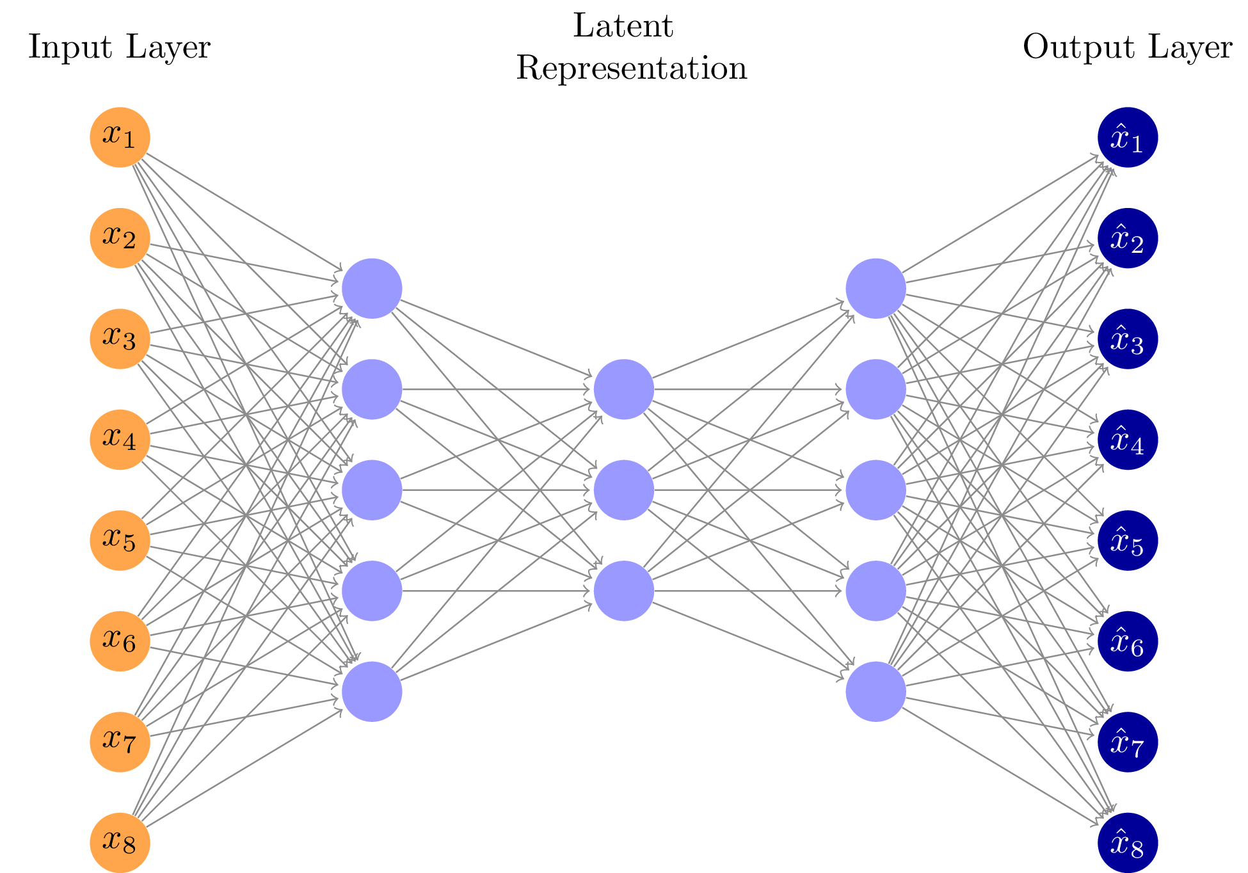
Section 11: Autoencoders
ISP008 foundation
Functions: compress input into a smaller version, and then try to recreate the input
Architecture: Input layer has same number of neurons as output layer, middle layers have fewer neurons
Purpose: dimensionality reduction, noise removal
2
Internal | C/ISP Krautschneider | 07.12.2017 V1.0
CISP-1352-A21 - ISP-DOC-STYLETYPE-Templates © Robert Bosch GmbH 2016. All rights reserved, also regarding any disposal, exploitation, reproduction, editing, distribution, as well as in the event of applications for industrial property rights.

Slide 3
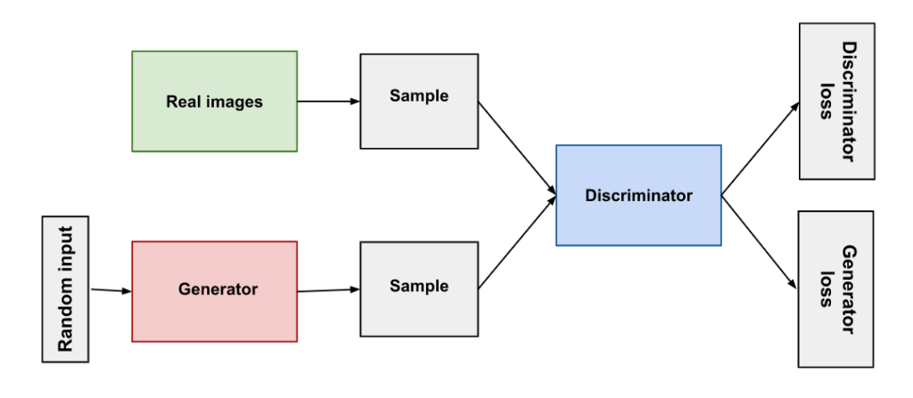
Section 12: Generative Adversarial Network
ISP008 foundation
Workflow:
Generator creates image from random input
Discriminator is fed with real images and fake images from Generator. Discriminator classifies real and fake ones, then calculates the losses for each category.
Training:
Phase 1: Train Discriminator to classify real vs fake images
Phase 2: Train Generator to better fool the Discriminator
2
Internal | C/ISP Krautschneider | 07.12.2017 V1.0
CISP-1352-A21 - ISP-DOC-STYLETYPE-Templates © Robert Bosch GmbH 2016. All rights reserved, also regarding any disposal, exploitation, reproduction, editing, distribution, as well as in the event of applications for industrial property rights.

Slide 4
Video defect detection using Deep Learning Techniques

Slide 5
Video defect detection using Deep Learning Techniques
ISP008 foundation
Impulse noise
Aliasing, blur
Periodic noise
Scratches and blotches
Snow
Freeze frame
Color channel interference
2
Internal | C/ISP Krautschneider | 07.12.2017 V1.0
CISP-1352-A21 - ISP-DOC-STYLETYPE-Templates © Robert Bosch GmbH 2016. All rights reserved, also regarding any disposal, exploitation, reproduction, editing, distribution, as well as in the event of applications for industrial property rights.

Slide 6
Video defect detection using Deep Learning Techniques
ISP008 foundation
Impulse noise: estimate_sigma (Gauss distribution)
Aliasing, blur
Periodic noise
Scratches and blotches
Snow
Freeze frame
Color channel interference
2
Internal | C/ISP Krautschneider | 07.12.2017 V1.0
CISP-1352-A21 - ISP-DOC-STYLETYPE-Templates © Robert Bosch GmbH 2016. All rights reserved, also regarding any disposal, exploitation, reproduction, editing, distribution, as well as in the event of applications for industrial property rights.

Slide 7
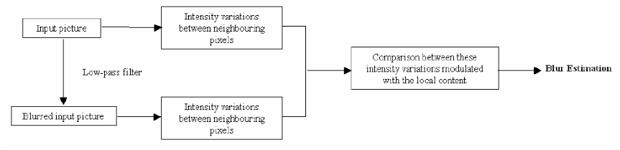
Video defect detection using Deep Learning Techniques
ISP008 foundation
Impulse noise: estimate_sigma (Gauss distribution)
Aliasing, blur: blur_effect (re-blurring filter)
Periodic noise
Scratches and blotches
Snow
Freeze frame
Color channel interference
2
Internal | C/ISP Krautschneider | 07.12.2017 V1.0
CISP-1352-A21 - ISP-DOC-STYLETYPE-Templates © Robert Bosch GmbH 2016. All rights reserved, also regarding any disposal, exploitation, reproduction, editing, distribution, as well as in the event of applications for industrial property rights.

Slide 8
Video defect detection using Deep Learning Techniques
ISP008 foundation
Impulse noise: estimate_sigma (Gauss distribution)
Aliasing, blur: blur_effect (re-blurring filter)
Periodic noise: Fast Fourier transform
Scratches and blotches
Snow
Freeze frame
Color channel interference
2
Internal | C/ISP Krautschneider | 07.12.2017 V1.0
CISP-1352-A21 - ISP-DOC-STYLETYPE-Templates © Robert Bosch GmbH 2016. All rights reserved, also regarding any disposal, exploitation, reproduction, editing, distribution, as well as in the event of applications for industrial property rights.

Slide 9
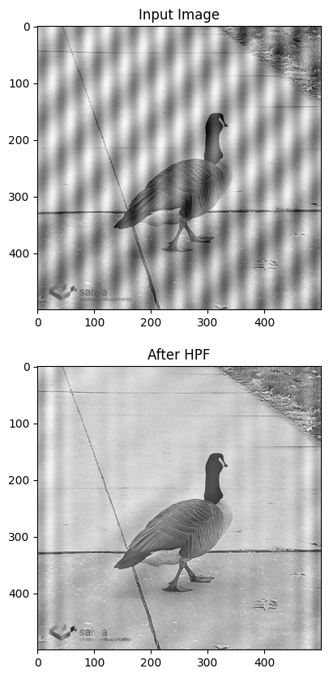
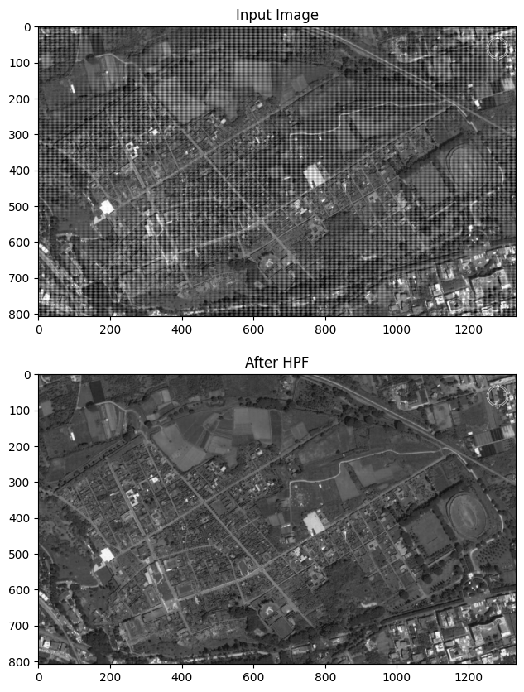
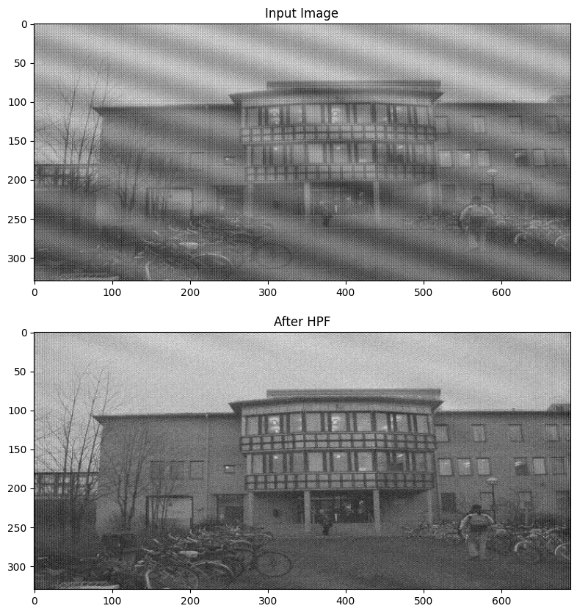
Fast Fourier Transform (FFT)
ISP008 foundation
2
Internal | C/ISP Krautschneider | 07.12.2017 V1.0
CISP-1352-A21 - ISP-DOC-STYLETYPE-Templates © Robert Bosch GmbH 2016. All rights reserved, also regarding any disposal, exploitation, reproduction, editing, distribution, as well as in the event of applications for industrial property rights.

Slide 10
Other tasks
ISP008 foundation
Install OSD-WSL (thanks to Trinh’s document)
Learn how to extract frames from video
Dataset for impulse noise, blur
2
Internal | C/ISP Krautschneider | 07.12.2017 V1.0
CISP-1352-A21 - ISP-DOC-STYLETYPE-Templates © Robert Bosch GmbH 2016. All rights reserved, also regarding any disposal, exploitation, reproduction, editing, distribution, as well as in the event of applications for industrial property rights.

Slide 11
Reference
ISP008 foundation
Autoencoder – TikZ.net
GAN Deep Learning: A Practical Guide (datagen.tech)
2
Internal | C/ISP Krautschneider | 07.12.2017 V1.0
CISP-1352-A21 - ISP-DOC-STYLETYPE-Templates © Robert Bosch GmbH 2016. All rights reserved, also regarding any disposal, exploitation, reproduction, editing, distribution, as well as in the event of applications for industrial property rights.

Slide 12
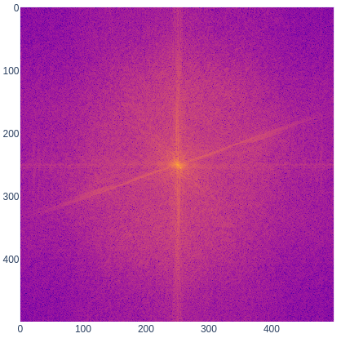
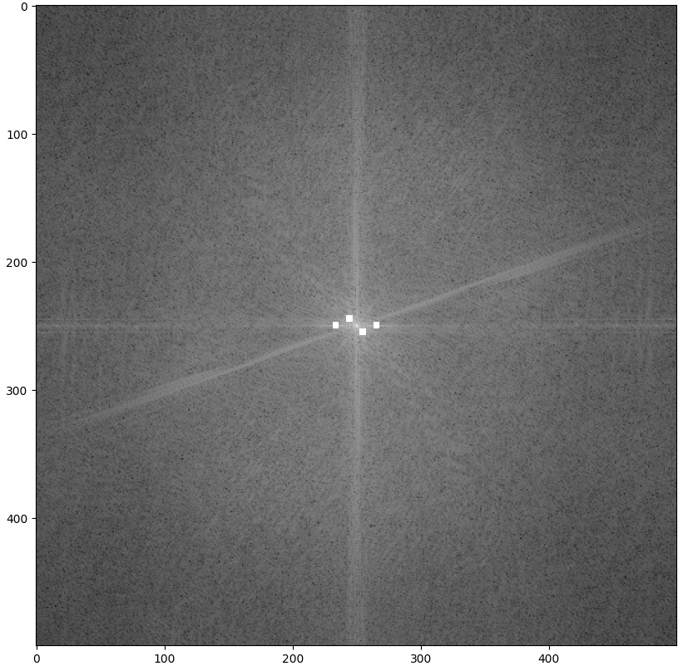
ISP008 foundation
2
Internal | C/ISP Krautschneider | 07.12.2017 V1.0
CISP-1352-A21 - ISP-DOC-STYLETYPE-Templates © Robert Bosch GmbH 2016. All rights reserved, also regarding any disposal, exploitation, reproduction, editing, distribution, as well as in the event of applications for industrial property rights.

